Slide 1

Dapr – 101
Garage Session By
Speaker - Ashish Pote

Slide 2


Distributed
Application
Runtime

Slide 3



Azure Incubation Team
Sandbox:
Incubation:
Graduated:

Slide 4
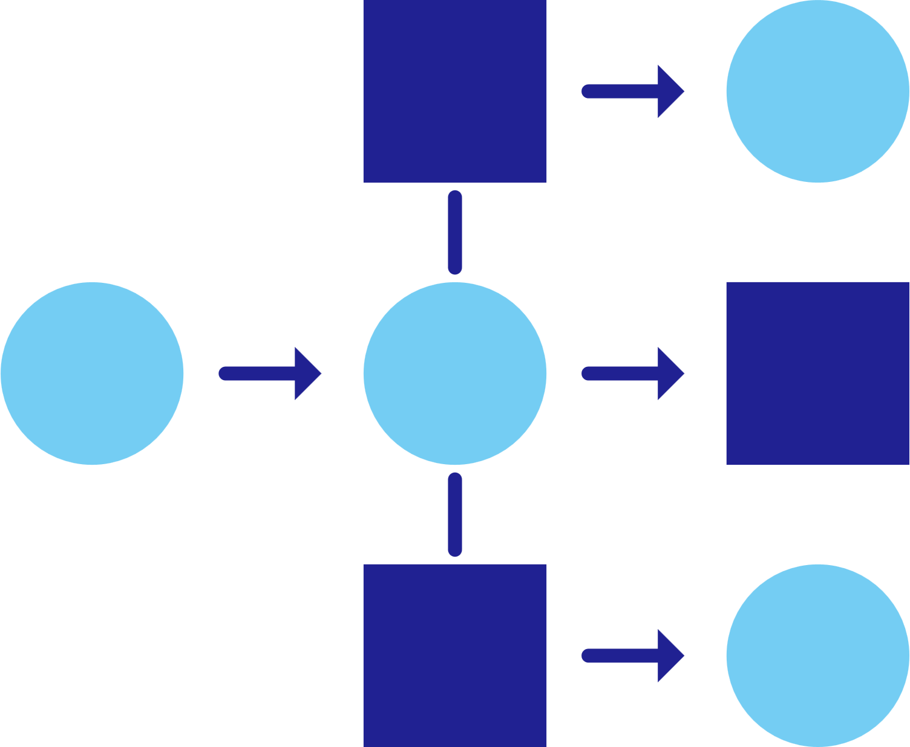
State of enterprise application
Must deploy scale-out apps for flexibility, cost, and efficiency
Must develop resilient, scalable, microservice-based apps that interact with services
Want to focus on
building applications, not learning infrastructure
Trending toward serverless platforms with simple code to cloud pipelines
Use multiple languages and frameworks during development

Slide 5
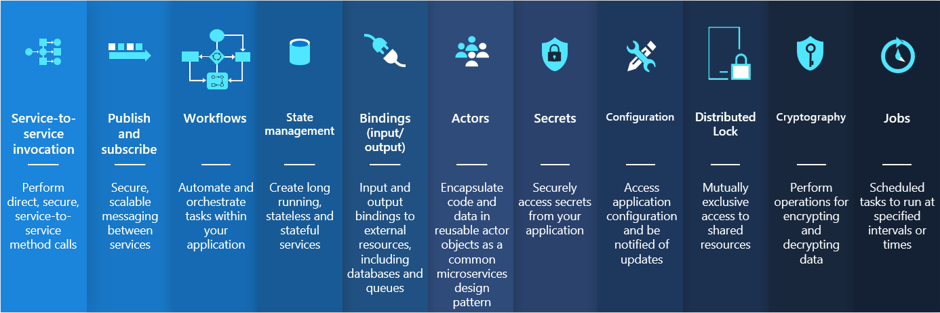
Microservice building blocks for cloud

Slide 6
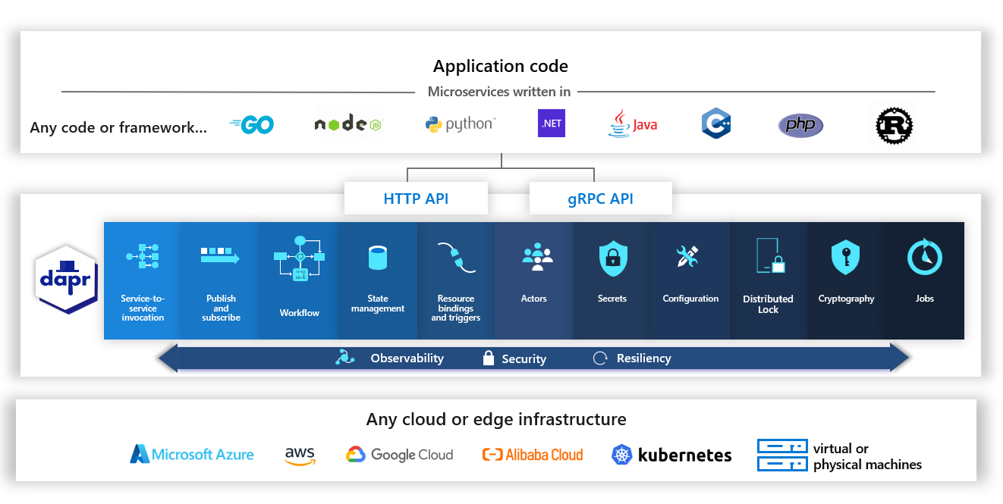
Dapr APIs

Slide 7

Sidecar Pattern
My App
SideCar
Core Functionality
Logging
Observability
Service Discovery
Resiliency
etc..

Slide 8
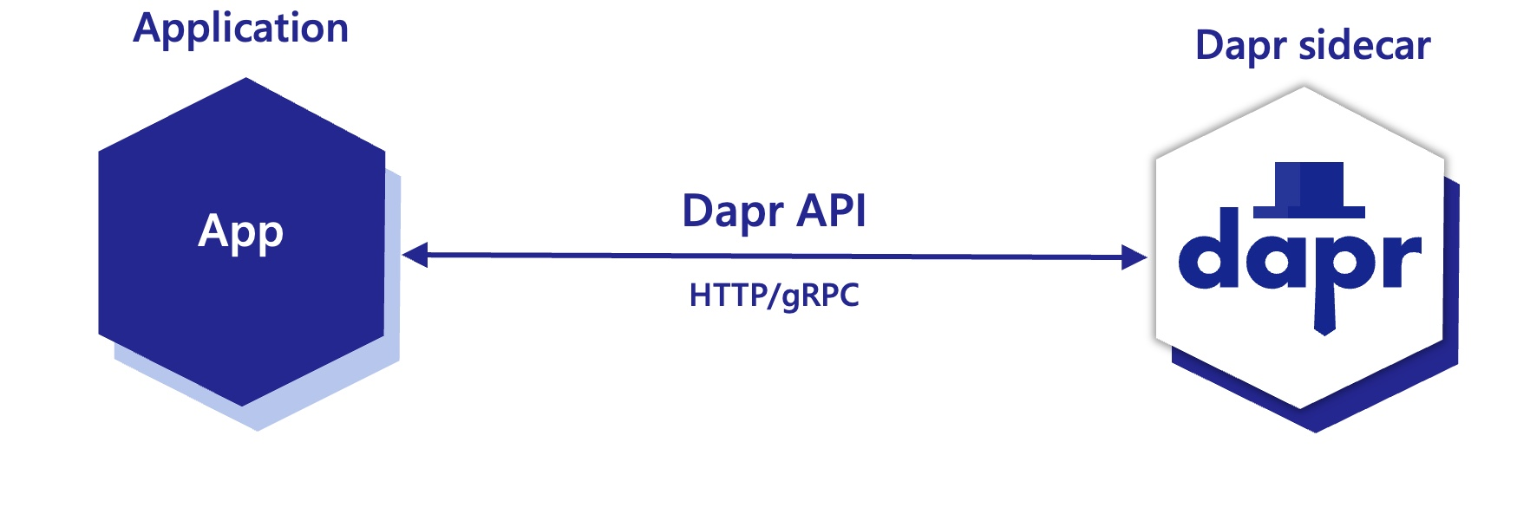
Dapr Sidecar Architecture
POST http://localhost:3500/v1.0/invoke/cart/method/order
GET http://localhost:3500/v1.0/state/inventory/item50
POST http://localhost:3500/v1.0/publish/mybroker/order-messages
GET http://localhost:3500/v1.0/secrets/vault/dbaccess
POST http://localhost:3500/v1.0-beta1/workflows/dapr/businessprocess/start

Slide 9
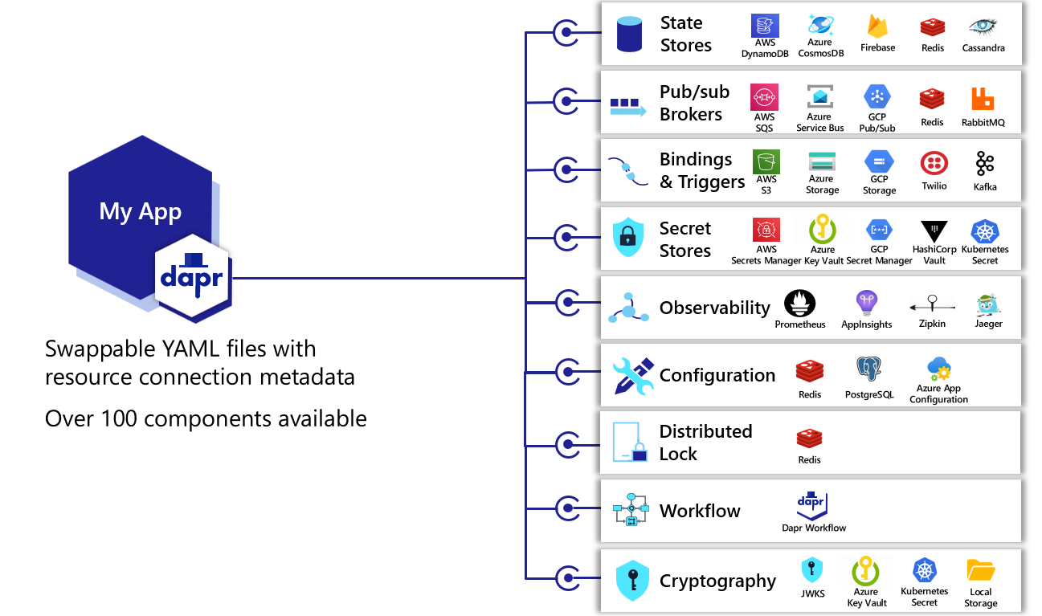
Dapr components

Slide 10






Swappable components
Service 2
Service 1
RabbitMQ
Service 3
Hashi Corp Vault
On Prem
Redis

Slide 11




Swappable components
Service 2
Service 1
Azure Service Bus
Service 3
Azure Key Vault
Azure
Cosmos DB

Slide 12




Swappable components
Service 2
Service 1
SNS
Service 3
KMS
DynamoDB

Slide 13
How to get started?

Slide 14
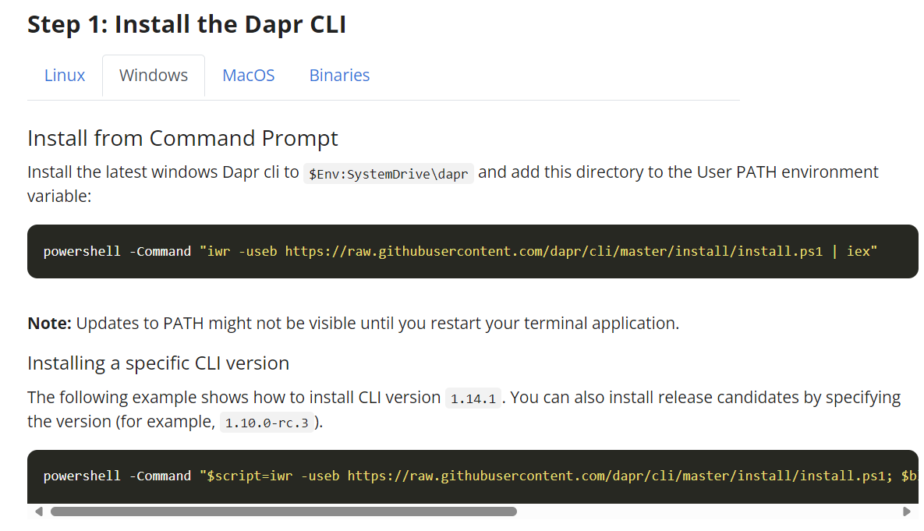
Install Dapr

Slide 15
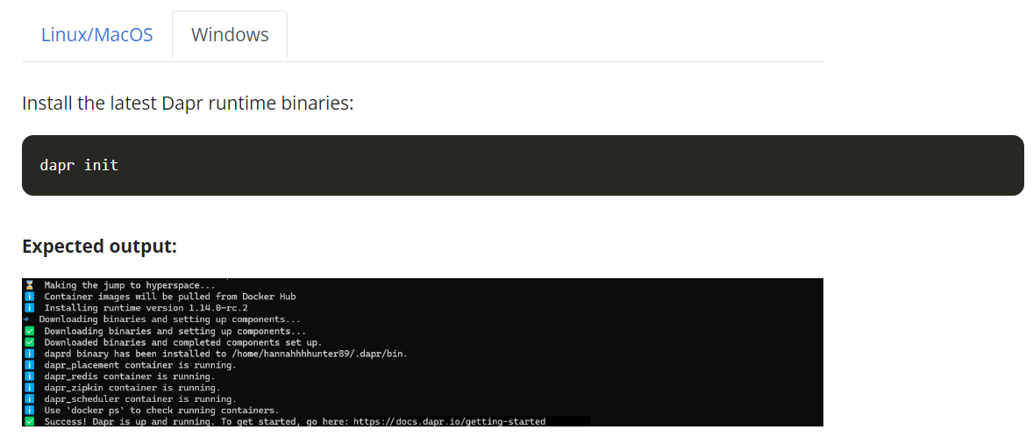
Initialize Dapr

Slide 16
Dapr Run
dapr run
--app-id serviceA
--app-port 8010
--dapr-http-port 8011
--app-protocol https
--log-as-json
--enable-api-logging
--resources-path ../dapr/component/azure
-- dotnet run --urls https://localhost:8010

Slide 17

Service Invocation
Service Discovery – name resolution using mDNS and Kube DNS
Standard API calls using Http and gRPC services
Configurable resiliency with automatic retries and back-offs
Built-in distributed tracing and metrics between Dapr and your infrastructure
Encrypted communication using mTLS for Dapr-to-Dapr and Dapr-control plane
Service invocation
Secure
service
communication

Slide 18

Service invocation - Demo
DNS
Name Resolution component for service discovery
(mDNS, Kubernetes DNS, Hashicorp Consul)
Service A
Send order
Service B
mTLS encryption
POST
http://localhost:8010/v1.0/invoke/invoke/serviceB
POST
http://10.0.0.2:8020/serviceB
{"data":"order1"}
{"data":"order1"}

Slide 19
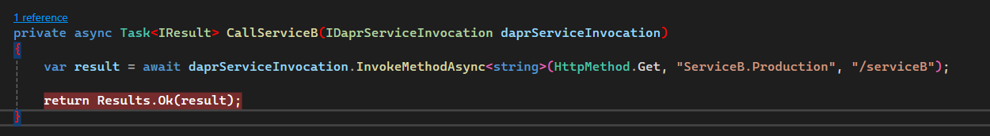
Namespace Service Invocation
localhost:8010/v1.0/invoke/serviceb.production/method/serviceB

Slide 20
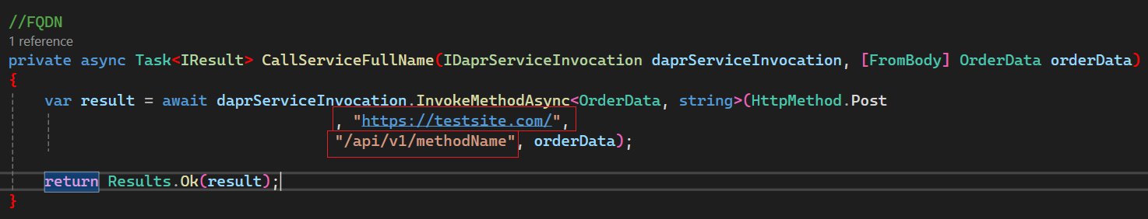
FQDN

Slide 21
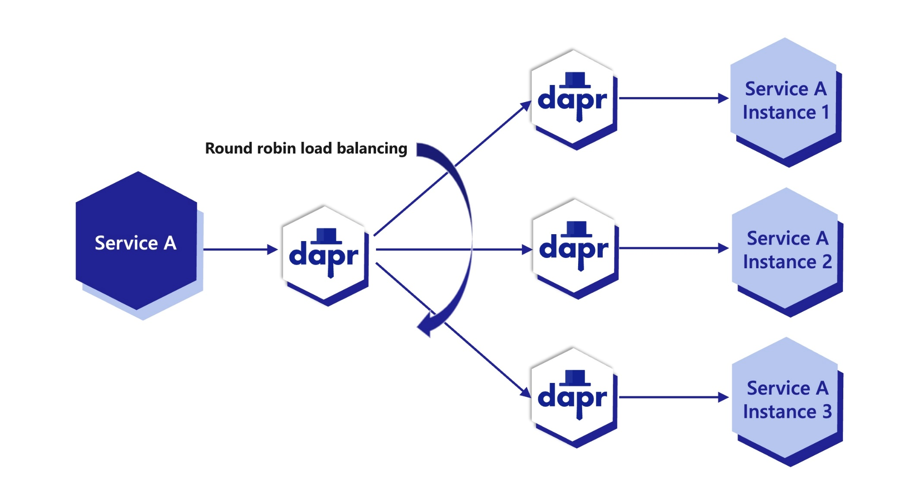
Multiple Replicas

Slide 22

Publish and Subscribe
A platform-agnostic messaging API
Sending messages using Cloudevents
Declarative, Programmatic, Streaming(1.14) Subscriptions
At-least-once message delivery
Topic Scoping for applications
Message Time-to-Live (TTL)
Publish / Subscribe
Secure, Scalable
messaging
between services

Slide 23


CloudEvents
Standardizing common
eventing metadata and their location
to help with event identification
and routing.
CloudEvents was accepted to CNCF on May 15, 2018, moved to the Incubating maturity level on October 24, 2019, and then moved to the Graduated maturity level on January 25, 2024.
https://cloudevents.io

Slide 24
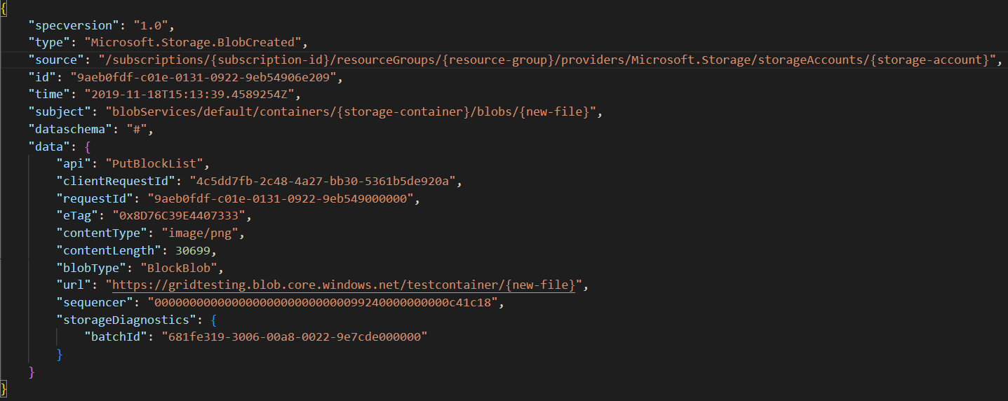
CloudEvents sample json

Slide 25
PubSub - Demo
Service A
Service B
Azure Service Bus
SNS

Slide 26
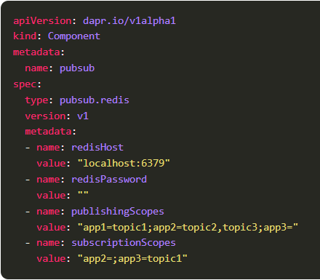
Scope topic access

Slide 27
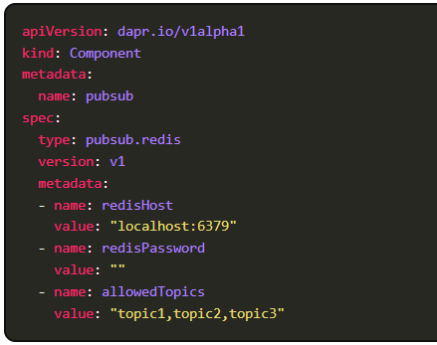
Limit Allowed Topic

Slide 28

State Management
Configurable concurrency and consistency behaviours
Use bulk operations
Resiliency policies
Limit access using scopes
Enable transactional outbox pattern
Encrypt state
Time-to-live
State Management
Secure, Scalable
messaging
between services

Slide 29

State Management - Demo
orderstore
Redis Cache
Service A
key | Field | value
||order1 | data | "myorder"
||order1 | version | 1
POST
http://localhost:3500/v1.0/state/orderstore
[{
"key": "order1",
"value": "myorder"
}]

Slide 30

Resiliency
Resiliency patterns can be applied across Dapr APIs
Timeout
Retries,
Circuit breakers
Declarative and decoupled from application code
Policies – constant, exponential
Targets and Health Checks – App health checks, Dapr sidecar health checks
Resiliency
Defining
and applying
Fault tolerance

Slide 31
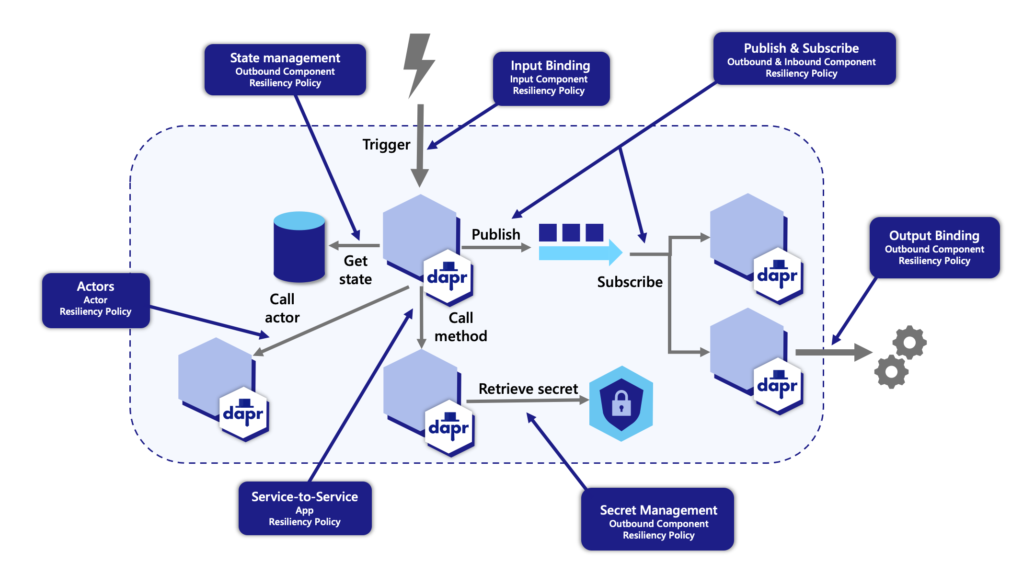
Dapr Resiliency

Slide 32
Service Invocation resiliency policies
Service invocation resiliency policies
1
The built-in service invocation retries are always performed with a backoff interval of 1 second up to a threshold of 3 times
Service A
Service B
1
Additionally, service invocation resiliency polices for `retries`, `timeouts and `circuit breakers` can be applied

Slide 33

Resiliency in Pub/Sub
Resiliency in Pub/Sub
1
1
Outbound component resiliency policies for `retries`, `timeouts and `circuit breakers` can be applied to message publishing
Inbound component resiliency polices for `retries`, `timeouts and `circuit breakers` policies can be applied to subscriptions when delivering messages
Service A
Service B
Outbound
Inbound
Pub/sub queue
1
Additionally, many pub/sub components have `retry` capabilities built-in. The policies are configured on a per component basis. For example, Kafka, RabbitMQ and Redis

Slide 34
Outbound component resiliency policies
1
Component resiliency polices for `retries`, `timeouts and `circuit breakers` can be applied to outbound component calls. For example, calls to persist state
Service A
Outbound
Component
1
Additionally, some components have `retry` capabilities built-in. The policies are configured on a per component basis. For example, Redis state store, RabbitMQ

Slide 35

Inbound component resiliency policies
1
Resiliency polices for `retries`, `timeouts and `circuit breakers` can be applied to inbound component calls. For example, pub/sub subscriptions and input bindings
Checkout
Inbound
Cron Input Binding

Slide 36

Security
Encrypted data and communication using mTLS
Access policies(Endpoint allow, deny ACLs)
Pub/Sub topic access policies(Topic allow, deny ACLs)
Scoping
Security
Built-in security

Slide 37

Observability
Open Telemetry (OTEL) and Zipkin protocols for distributed
Most observability tools support
Google Cloud Operations, AWS X-Ray, Azure Monitor, New Relic, Datadog, Zipkin, Jaeger, SignalFX
Metrics can be pushed to Prometheus, Grafana, Azure Monitor
Dapr Logging
Observability
Built-in security

Slide 38

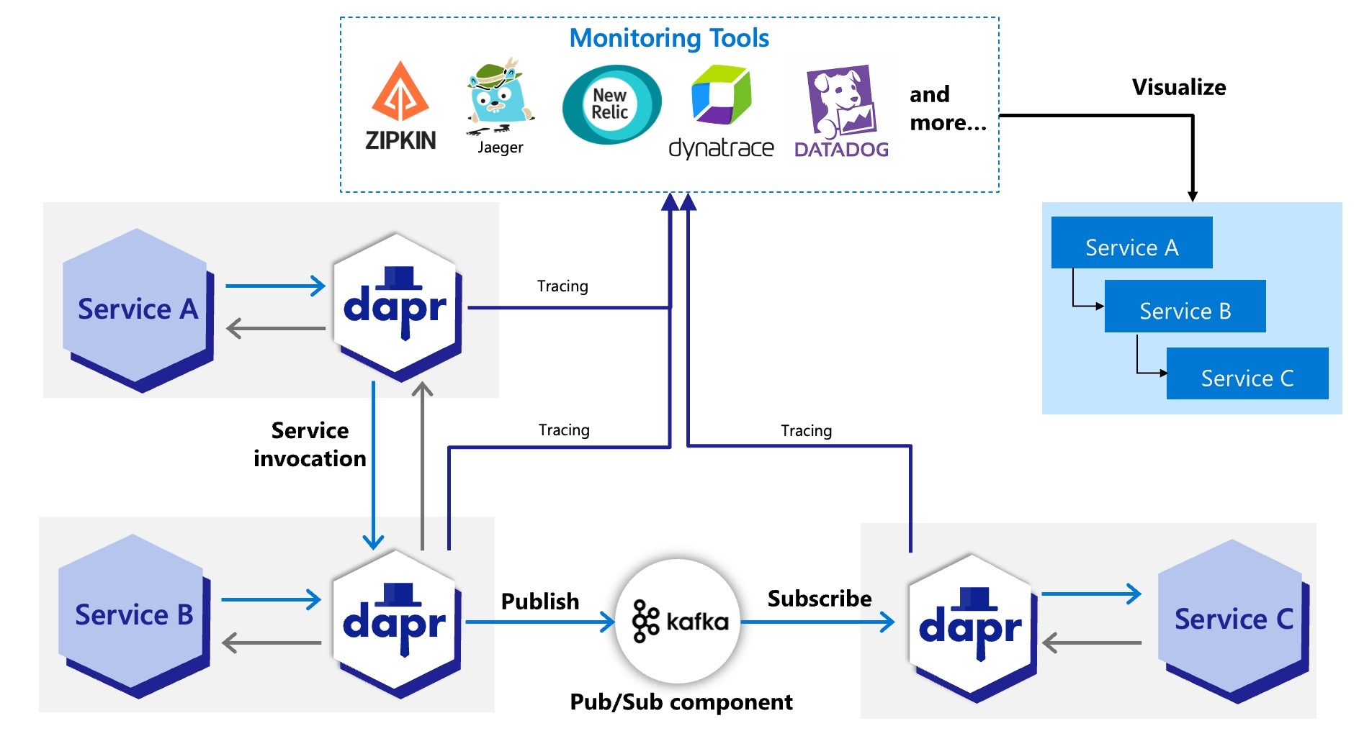
Distributed Tracing

Slide 39
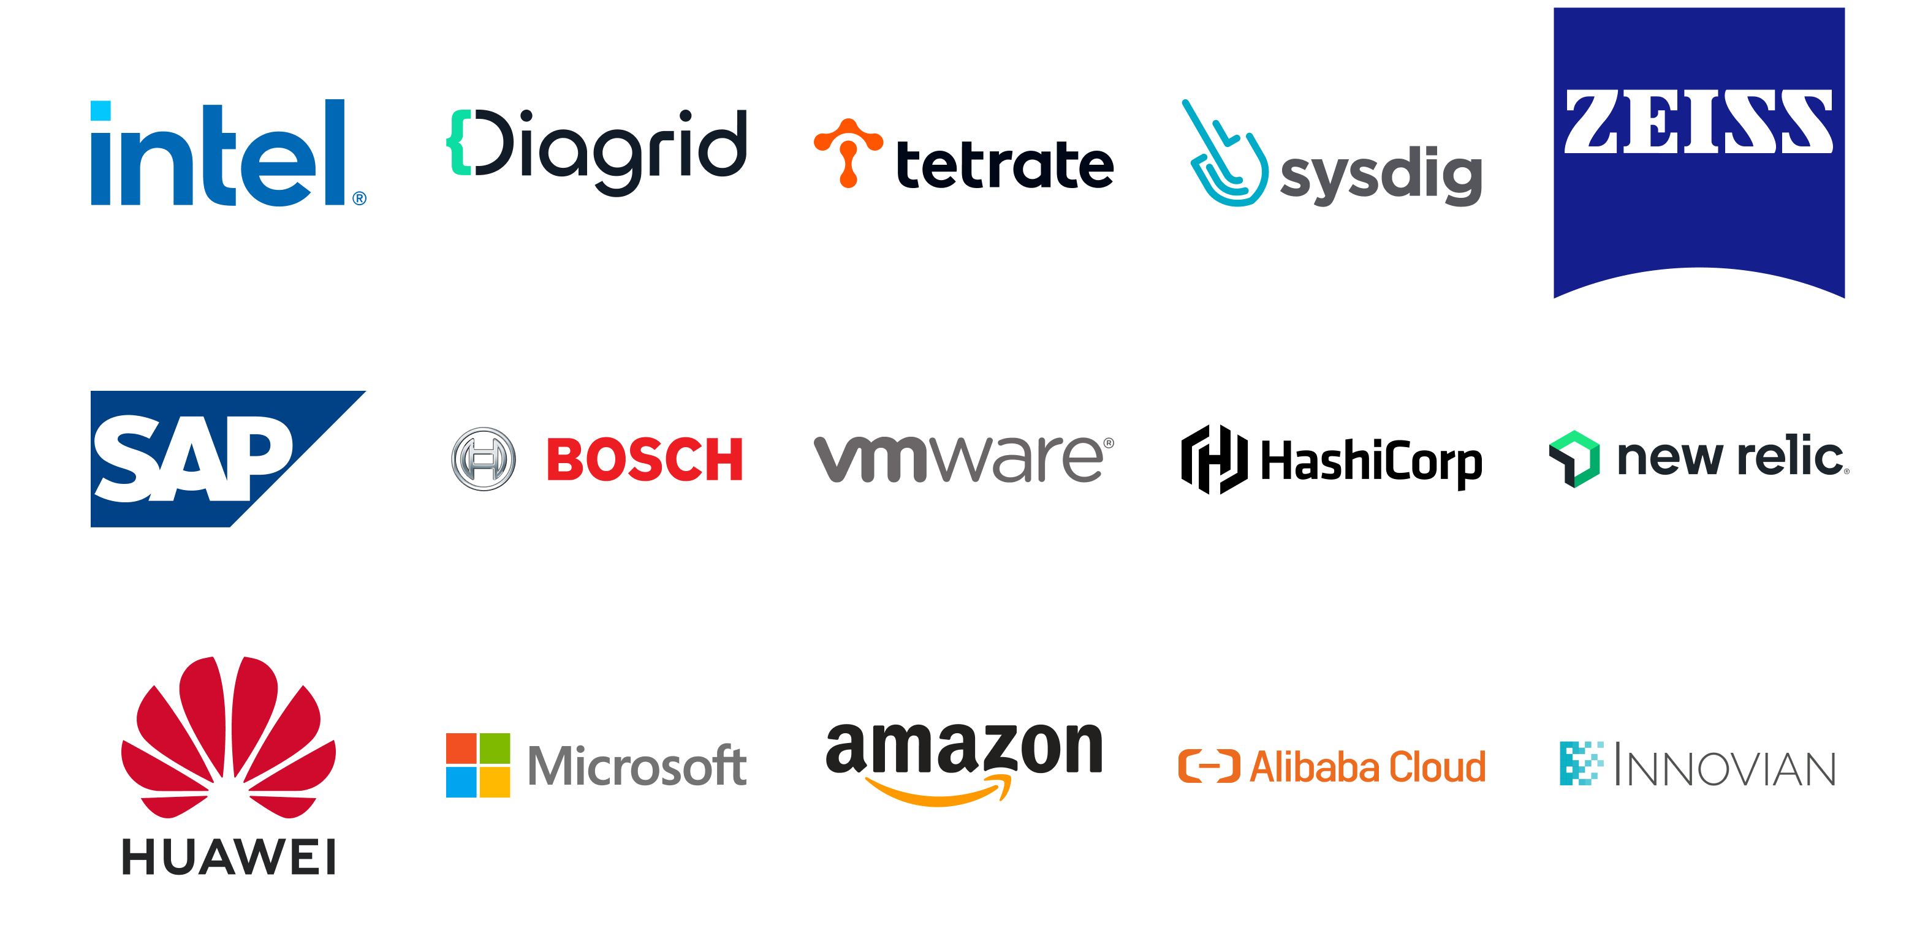
Dapr Contributors

Slide 40
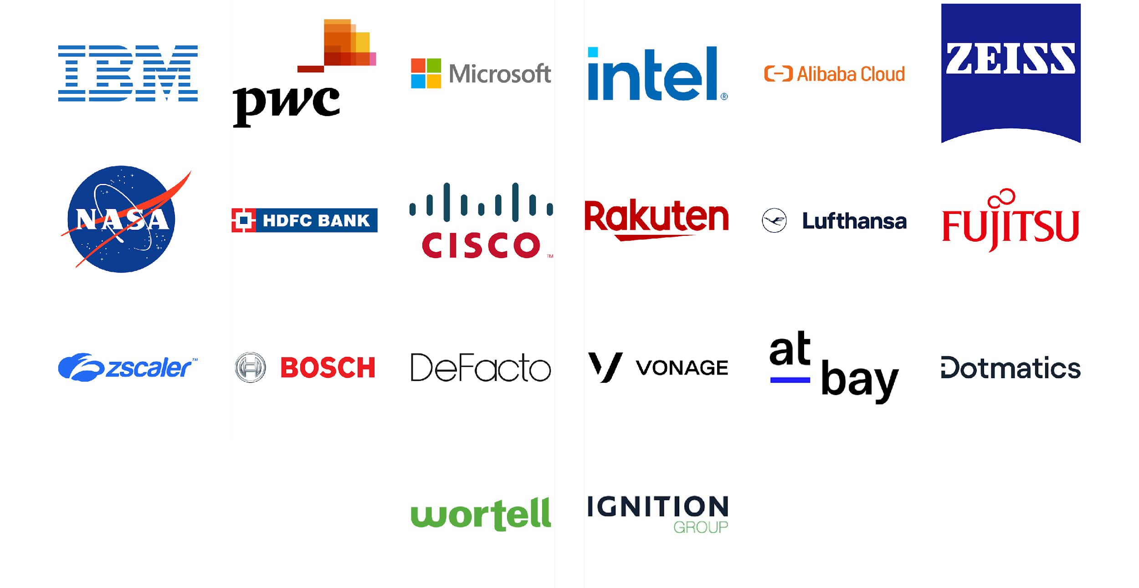
Dapr Users

Slide 41






Dapr Resources
dapr.io
bit.ly/dapr-youtube
bit.ly/dapr-quickstarts
bit.ly/dapr-discord
@daprdev

Slide 42
FAQs
Is Dapr like a Service Mesh?
Does Dapr provision Infrastructure?

Slide 43
Thank you

